Slide 1
2022 Assessment of the Efficiency of the Administrative Mechanism (AEAM) (August 2022)
Notes:
Are your classroom colors different than what you see in this template? That’s OK! Click on Design -> Variants (the down arrow) -> Pick the color scheme that works for you!
Feel free to change any “You will…” and “I will…” statements to ensure they align with your classroom procedures and rules!

Slide 2
What is the Assessment of the Efficiency of the Administrative Mechanism (AEAM) and why do we do it?
The purpose of this project is to conduct the Assessment of Efficiency of the Administrative Mechanism (AEAM). Federal legislation requires each Ryan White Part A Planning Council to assess the efficiency of the administrative mechanism. This mean the efficiencies of the Administrative Agent, the City of Paterson, New Jersey, Bergen-Passaic TGA Ryan White Part A Program, to rapidly allocate funds to the areas of greatest need within the TGA, and at the discretion of the Planning Council, assess the effectiveness of the services offered in meeting the identified needs.
The City of Paterson, New Jersey, Bergen-Passaic TGA Ryan White Part A Program, served as the Recipient for administering the Ryan White Part A Program (RWPA) for this reporting period. The purpose of the Assessment is to ensure that service prioritization and allocation, as determined by the Planning Council during their Priority Setting and Resource Allocations (PSRA) process are adhered to.
The AEAM will also assess efficiencies in the Recipient’s ability to procure services through contracting and reimbursement processes. Ultimately, the Planning Council will assess the Recipient’s ability to facilitate access to primary medical care and other ancillary services by Persons Living with HIV/AIDS (PLWH).
The Steering Committee of the Planning Council develops the timeline and Scope of Work for the Assessment of the Efficiency of the Administrative Mechanism for the TGA.

Slide 3
AEAM Questions to Subrecipients
Questions
1. During the 2022 grant year (March 1, 2022 - February 28, 2023), did your agency receive an executed contract within 45 days of your letter of award issued by the Recipient's Office (City of Paterson)? 2. During the 2022 grant year (March 1, 2022 - February 28, 2023), did your agency receive payment from the City of Paterson within 30 days of submitting a correct cash voucher/reimbursement request to the Recipient's Office? 3. During the 2022 grant year (March 1, 2022 - February 28, 2023), did your agency receive a notification from the Recipient's Office that your cash voucher/reimbursement request needed to be modified/corrected? 4. During the 2022 grant year (March 1, 2022 - February 28, 2023), on average, how many days elapsed between the day you submitted your cash voucher/reimbursement request and the date you were notified by the Recipient's office that corrections were needed?

Slide 4
AEAM Questions to Subrecipients
Questions
5. During the 2022 grant year (March 1, 2022 - February 28, 2023), did your agency submit a budget modification/amendment (request to change the amount of money allocated to a service category) to the Recipient's office? 6. During the 2022 grant year (March 1, 2022 - February 28, 2023), on average, how many days did it take for the Recipient's office to approve the requested budget modification/amendment? 7. During the 2022 grant year (March 1, 2022 - February 28, 2023), did your agency receive a Program Monitoring (chart audit for services) visit? 8. During the 2022 grant year (March 1, 2022 - February 28, 2023), did your agency receive a Fiscal Monitoring (audit for Ryan White expenses) visit? 9. During the 2022 grant year (March 1, 2022 - February 28, 2023), did your agency request any technical assistance from the Recipient's office?

Slide 5
During the 2022 grant year (March 1, 2022 - February 29, 2023), did your agency receive an executed contract within 45 days of your letter of award issued by the Recipient's Office (City of Paterson)?
SUBRECIPIENT RESPONSES:
A few months later
It was after 45 days

Slide 6
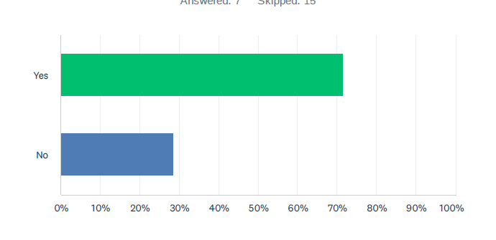
During the 2022 grant year (March 1, 2022 - February 29, 2023), did your agency receive payment from the City of Paterson within 30 days of submitting a correct cash voucher/reimbursement request to the Recipient's Office?
SUBRECIPIENT RESPONSES:
1. It takes longer than 30 days

Slide 7
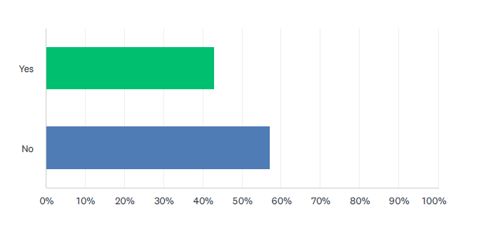
During the 2022 grant year (March 1, 2022 - February 29, 2023), did your agency receive a notification from the Recipient's Office that your cash voucher / reimbursement request needed to be modified/corrected?
SUBRECIPIENT RESPONSES:
1. We did not need to correct ay vouchers
2. It was correct
3. N/A

Slide 8
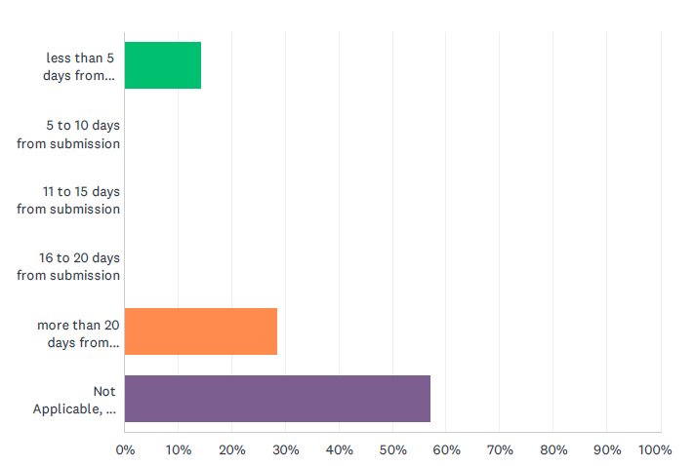
During the 2022 grant year (March 1, 2022 - February 29, 2023), on average, how many days elapsed between the day you submitted your cash voucher/ reimbursement request and the date you were notified by the Recipient's office that corrections were needed?
SUBRECIPIENT RESPONSES:
None

Slide 9
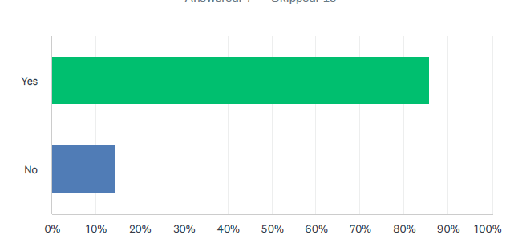
During the 2022 grant year (March 1, 2022 - February 29, 2023), did your agency submit a budget modification/amendment (request to change the amount of money allocated to a service category) to the Recipient's office?
SUBRECIPIENT RESPONSES:
We shifted money between categories
Needed to switch money among services internally

Slide 10
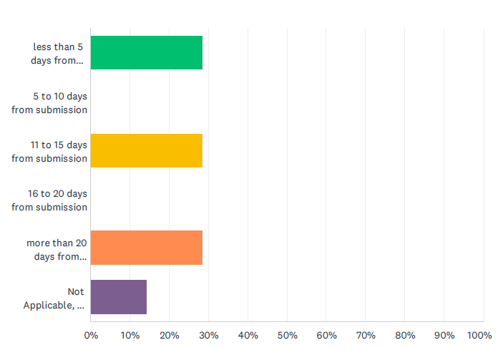
During the 2022 grant year (March 1, 2022 - February 29, 2023), on average, how many days did it take for the Recipient's office to approve the requested budget modification/amendment?
SUBRECIPIENT RESPONSES:
None

Slide 11
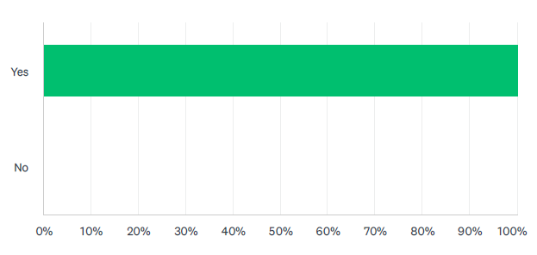
During the 2022 grant year (March 1, 2022 - February 29, 2023), did your agency receive a Program Monitoring (chart audit for services) visit?
SUBRECIPIENT RESPONSES:
None

Slide 12
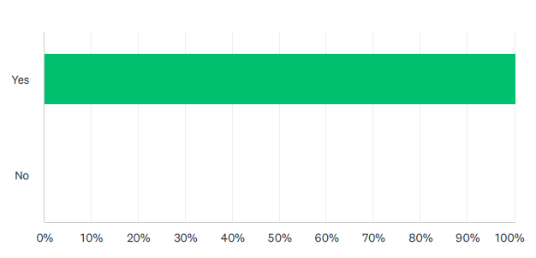
During the 2022 grant year (March 1, 2022 - February 29, 2023), did your agency receive a Fiscal Monitoring (audit for Ryan White expenses) visit?
SUBRECIPIENT RESPONSES:
None

Slide 13
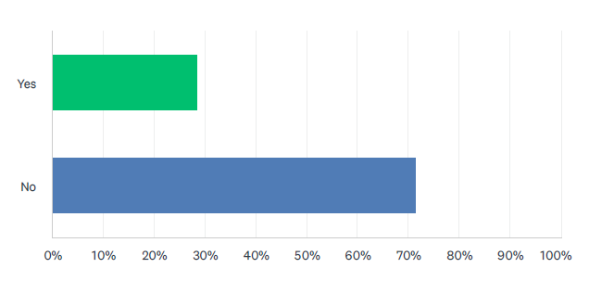
During the 2022 grant year (March 1, 2022 - February 29, 2023), did your agency request any technical assistance from the Recipient's office?
SUBRECIPIENT RESPONSES:
None

Slide 14
AEAM Questions to the Planning Council
Questions
During the 2022 grant year (March 1, 2022 - February 29, 2023), did the Recipients Office (City of Paterson) adhere to the Planning Council's recommendations by allocating a specific percentage of funds to each service category as approved by the Planning Council during the Priority Setting and Resource Allocations process? During the 2022 Ryan White Part A grant year (March 1, 2022 - February 28, 2023), did the Recipient's Office provide expenditure reports to the Planning Council at least 4 times? During the 2022 Ryan White Part A grant year (March 1, 2022 - February 28, 2023), did the Recipient's Office participate in the development of Needs Assessments? During the 2022 Ryan White Part A grant year (March 1, 2022 - February 28, 2023), did the Recipient's Office participate in the development and tracking of the Integrated HIV Prevention and Care Plan? During the 2022 Ryan White Part A grant year (March 1, 2022 - February 28, 2023), did the Recipient's Office participate in the development and update of Service Standards?

Slide 15
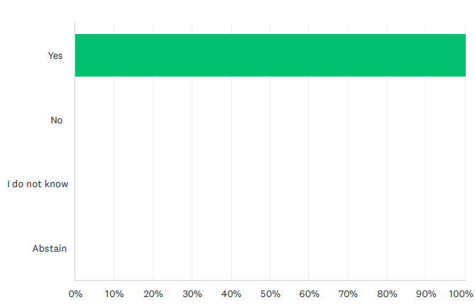
During the 2022 grant year (March 1, 2022 - February 29, 2023), did the Recipients Office (City of Paterson) adhere to the Planning Council's recommendations by allocating a specific percentage of funds to each service category as approved by the Planning Council during the Priority Setting and Resource Allocations process?
COMMISSIONER RESPONSES:
None

Slide 16
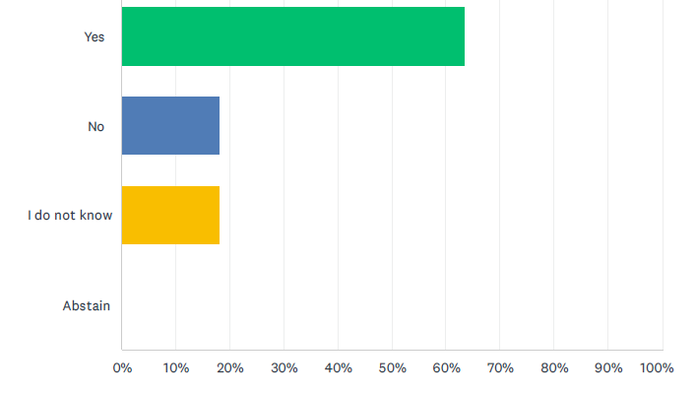
During the 2022 Ryan White Part A grant year (March 1, 2022 - February 28, 2023), did the Recipient's Office provide expenditure reports to the Planning Council at least 4 times?
COMMISSIONER RESPONSES:
She has become very lax in providing reports to the Council
I would prefer allocation reports to be more regular and predictable
The recipient was very seldom at a meeting to provide explanations/answer questions! The consultant is not the recipient

Slide 17
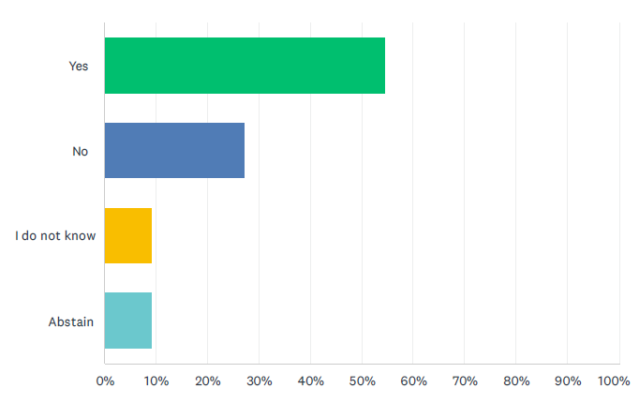
During the 2022 Ryan White Part A grant year (March 1, 2022 - February 28, 2023), did the Recipient's Office participate in the development of Needs Assessments?
COMMISSIONER RESPONSES:
She leaves things to the consultant
The recipient office was not available at the discussion meetings
No available…never there.

Slide 18
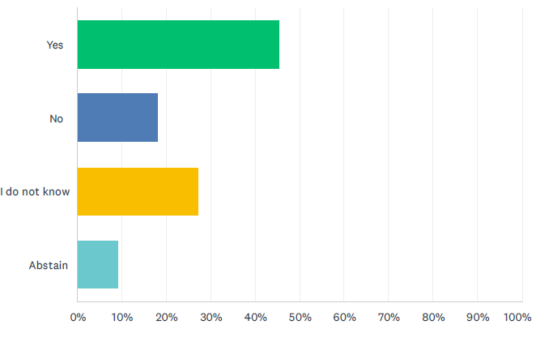
During the 2022 Ryan White Part A grant year (March 1, 2022 - February 28, 2023), did the Recipient's Office participate in the development and tracking of the Integrated HIV Prevention and Care Plan?
COMMISSIONER RESPONSES:
In fairness, her office has been extremely understaffed and much of her work was left to the consultants to do.
The recipient was not available at these discussions either.

Slide 19
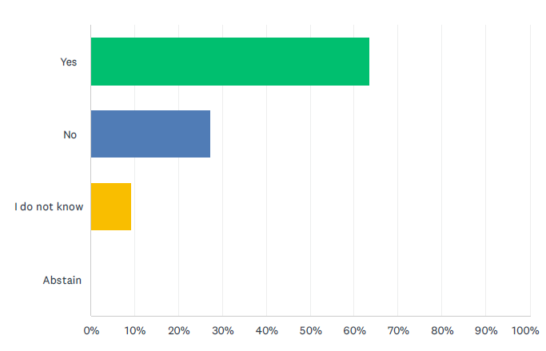
During the 2022 Ryan White Part A grant year (March 1, 2022 - February 28, 2023), did the Recipient's Office participate in the development and update of Service Standards?
COMMISSIONER RESPONSES:
Same as above
The consultant did but no the recipient
If they were done at all, it was the consultant

Slide 20
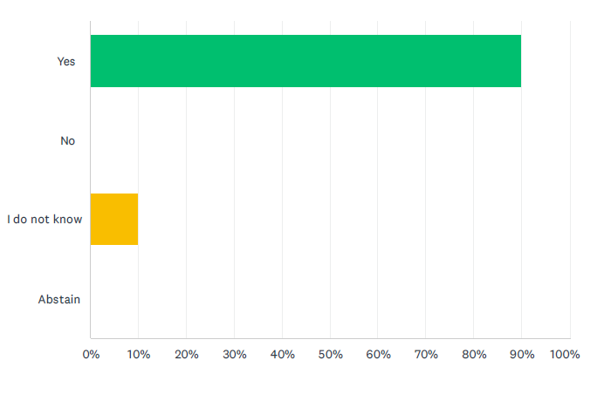
During the 2022 Ryan White Part A grant year (March 1, 2022 - February 28, 2023), did the Recipient's Office participate in the coordination of Planning Council Support operations?
COMMISSIONER RESPONSES:
Same as above
I suppose you can say yes if it means paying the consultants

Slide 21
Recommendations for AEAM Results?
DISCUSSION:

